Slide 1
MTH 166 Lecture-31
Greens’ Theorem

Slide 2
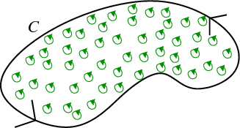
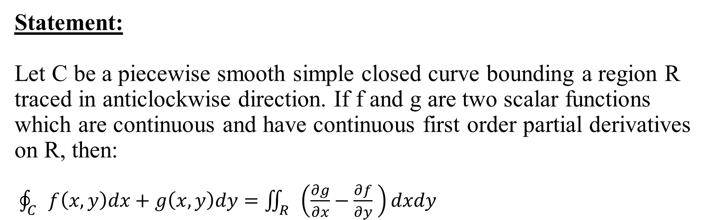
Statement: Let C be a piecewise smooth simple closed curve bounding a region R traced in anticlockwise direction. If f and g are two scalar functions which are continuous and have continuous first order partial derivatives on R, then: $\oint_{C}{f\left(x,y\right)dx+g\left(x,y\right)dy}=\iint_{R}{\left(\frac{∂g}{∂x}−\frac{∂f}{∂y} \right)dxdy}$
This Photo by Unknown Author is licensed under CC BY-SA

Slide 3
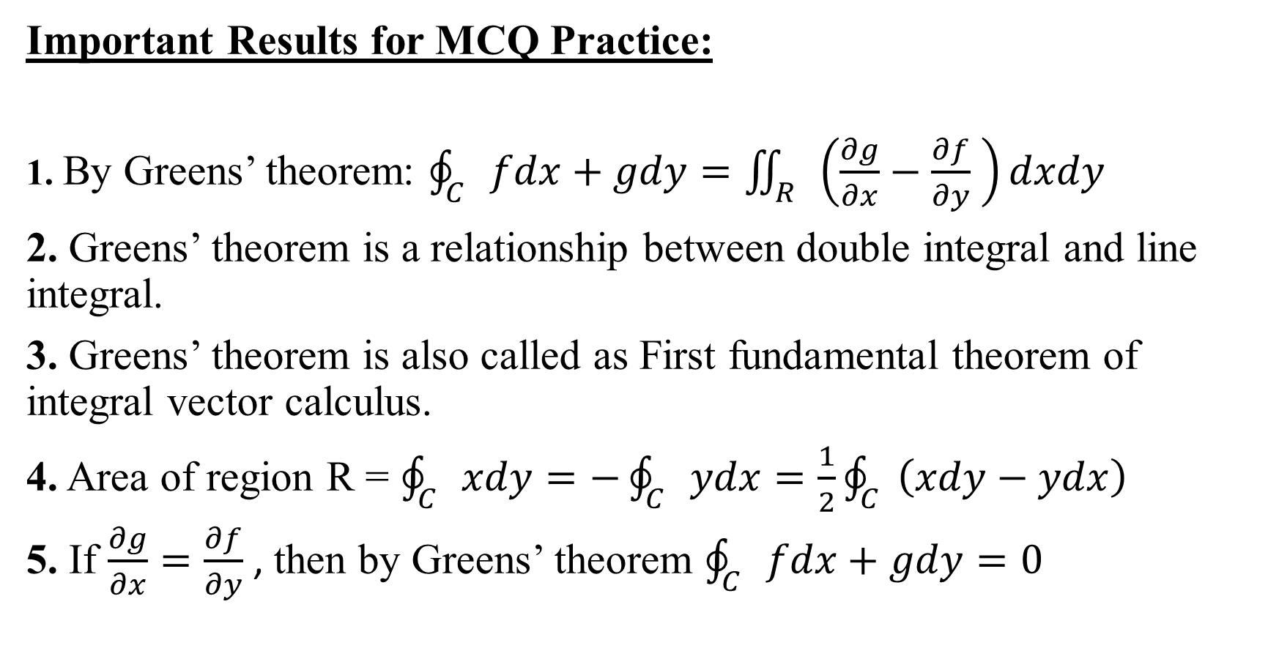
Important Results for MCQ Practice:
1. By Greens’ theorem: $\oint_{C}{fdx+gdy}=\iint_{R}{\left(\frac{∂g}{∂x}−\frac{∂f}{∂y} \right)dxdy}$
2. Greens’ theorem is a relationship between double integral and line integral.
3. Greens’ theorem is also called as First fundamental theorem of integral vector calculus.
4. Area of region R = $\oint_{C}{xdy}=−\oint_{C}{ydx}=\frac{1}{2}\oint_{C}{\left(xdy−ydx\right)}$
5. If $\frac{∂g}{∂x}=\frac{∂f}{∂y}$ , then by Greens’ theorem $\oint_{C}{fdx+gdy}=0$

Slide 4
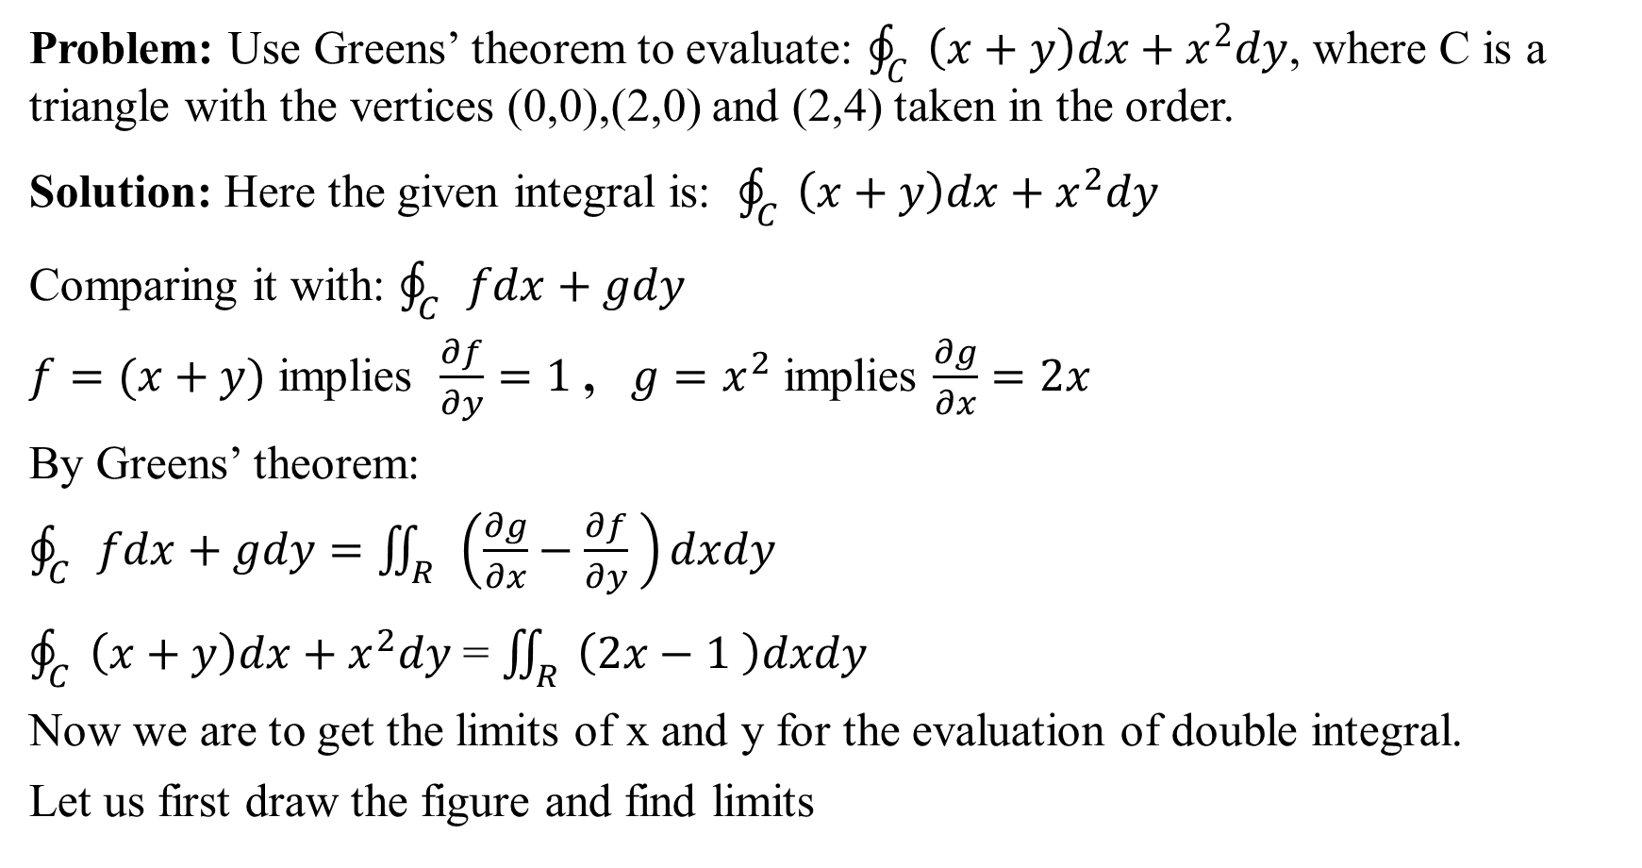
Problem: Use Greens’ theorem to evaluate: $\oint_{C}{\left(x+y\right)dx+x^{2}dy}$, where C is a triangle with the vertices (0,0),(2,0) and (2,4) taken in the order.
Solution: Here the given integral is: $\oint_{C}{\left(x+y\right)dx+x^{2}dy}$
Comparing it with: $\oint_{C}{fdx+gdy}$
$f=(x+y)$ implies $\frac{∂f}{∂y}=1$ , $g=x^{2}$ implies $\frac{∂g}{∂x}=2x$
By Greens’ theorem:
$\oint_{C}{fdx+gdy}=\iint_{R}{\left(\frac{∂g}{∂x}−\frac{∂f}{∂y} \right)dxdy}$
$\oint_{C}{\left(x+y\right)dx+x^{2}dy}$ = $\iint_{R}{\left(2x−1 \right)dxdy}$
Now we are to get the limits of x and y for the evaluation of double integral.
Let us first draw the figure and find limits

Slide 5
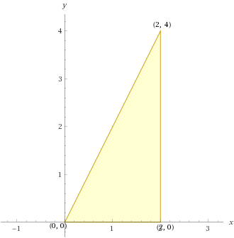

In the given figure: $R:\left\{\begin{matrix}0≤x≤2 \\ 0≤y≤2x\end{matrix}\right\}$
Now, Let us evaluate the integral:

Slide 6

$\oint_{C}{\left(x+y\right)dx+x^{2}dy}$ = $\iint_{R}{\left(2x−1 \right)dxdy}$
$=\int_{x=0}^{2}{\int_{y=0}^{2x}{\left(2x−1\right)dydx}}$
$=\int_{x=0}^{2}{{\left(2xy−y\right)}_{y=0}^{y=2x}dx}$
$=\int_{x=0}^{x=2}{\left(4x^{2}−2x\right)dx}$
$=\left[4\left(\frac{8}{3}\right)−4\right]$
$=\frac{20}{3}$ Answer

Slide 7
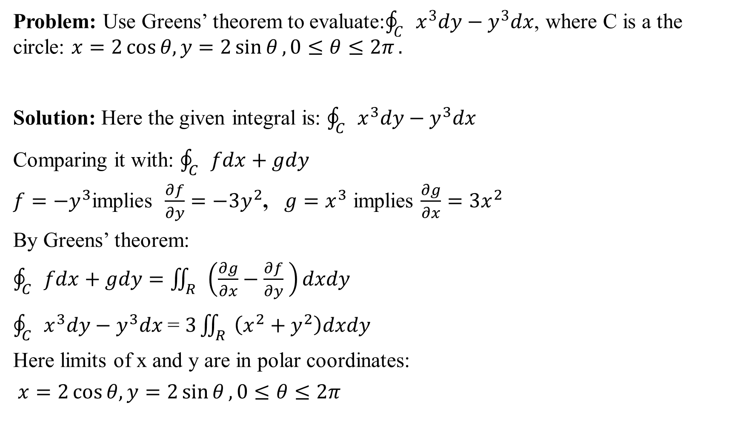
Problem: Use Greens’ theorem to evaluate:$\oint_{C}{x^{3}dy−y^{3}dx}$, where C is a the circle: $x=2\cos{θ, y=2\sin{θ}, 0≤θ≤2π}.$
Solution: Here the given integral is: $\oint_{C}{x^{3}dy−y^{3}dx}$
Comparing it with: $\oint_{C}{fdx+gdy}$
$f=−y^{3}$implies $\frac{∂f}{∂y}=−{3y}^{2}$, $g=x^{3}$ implies $\frac{∂g}{∂x}={3x}^{2}$
By Greens’ theorem:
$\oint_{C}{fdx+gdy}=\iint_{R}{\left(\frac{∂g}{∂x}−\frac{∂f}{∂y} \right)dxdy}$
$\oint_{C}{x^{3}dy−y^{3}dx}$= $3\iint_{R}{\left(x^{2}+y^{2}\right)dxdy}$
Here limits of x and y are in polar coordinates:
$x=2\cos{θ, y=2\sin{θ}, 0≤θ≤2π}$

Slide 8
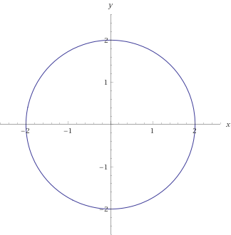

In the given region R: $0≤r≤2$, $0≤θ≤2π$

Slide 9

$\oint_{C}{x^{3}dy−y^{3}dx}$= $3\iint_{R}{\left(x^{2}+y^{2}\right)dxdy}$
$=3\int_{r=0}^{2}{\int_{θ=0}^{2π}{\left(r^{2}\right)rdrdθ}}$
$=3\int_{r=0}^{2}{r^{3}dr\int_{θ=0}^{2π}{dθ}}$
$=3{\left[\frac{r^{4}}{4}\right]}_{r=0}^{2}{\left[θ\right]}_{θ=0}^{2π}$
$=3\left(4\right)\left(2π\right)$
$=24π$ Answer

Slide 10
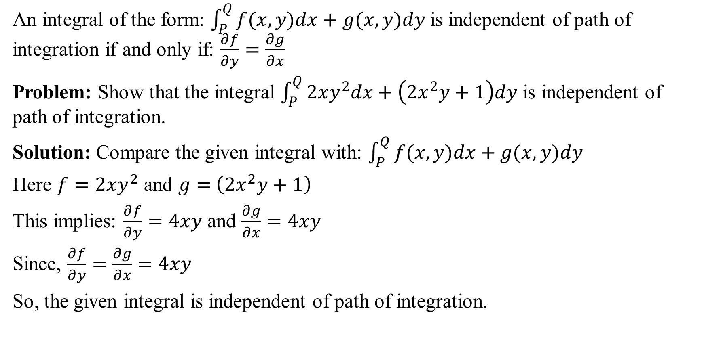
Line Integral Independent of Path of Integration
An integral of the form: $\int_{P}^{Q}{f(x,y)dx+g(x,y)dy}$is independent of path of integration if and only if: $\frac{∂f}{∂y}=\frac{∂g}{∂x}$
Problem: Show that the integral $\int_{P}^{Q}{2xy^{2}dx+\left(2x^{2}y+1\right)dy}$ is independent of path of integration.
Solution: Compare the given integral with: $\int_{P}^{Q}{f(x,y)dx+g(x,y)dy}$
Here $f=2xy^{2}$ and $g=$ $\left(2x^{2}y+1\right)$
This implies: $\frac{∂f}{∂y}=4xy$ and $\frac{∂g}{∂x}=4xy$
Since, $\frac{∂f}{∂y}=\frac{∂g}{∂x}=4xy$
So, the given integral is independent of path of integration.

Slide 11

This Photo by Unknown Author is licensed under CC BY

